Slide 1



Slide 2

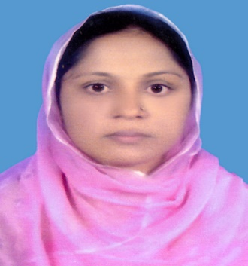
IDENTITY
Selina Akter
Asst.teacher
Bohoddar kata High School
Chakaria,Cox’s Bazar
E-mail: selikamal8485@gmail.com
Mobile:01815851776
English 2nd paper
CLASS : Nine

Slide 3


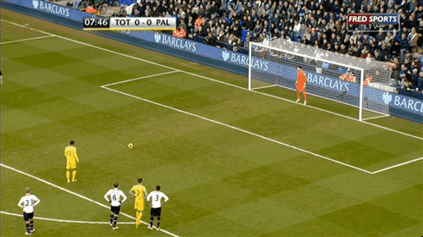
Lets see some pictures-
They are playing.
He reads.

Slide 4
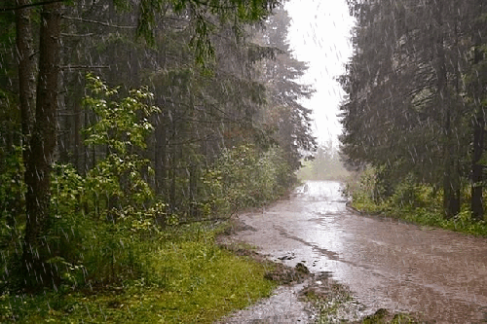

I have bought an umbrella.
It has been raining for two hours.

Slide 5

What have you observed by the pictures?
Different forms of-
present tense.

Slide 6

Our today’s topic is-
The forms of-
present tenses

Slide 7
Learning outcomes
At the end of the lesson, we will be able to—
identify the forms of present tense.
identify the structures of the forms of present tense.
transfer from one to another form.
identify the structures of the forms of the sentences.

Slide 8
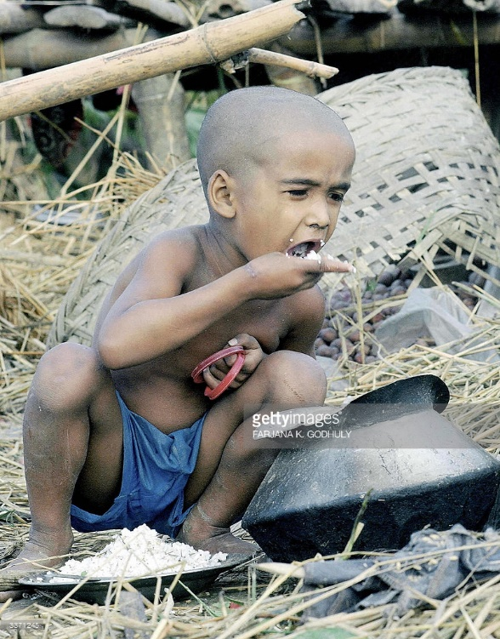
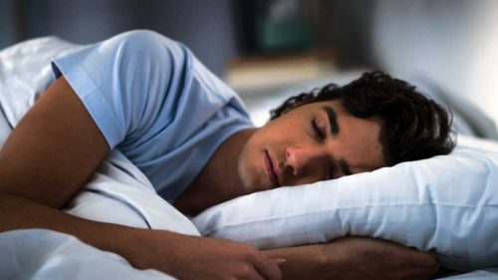
He is sleeping
The boy eats rice.

Slide 9
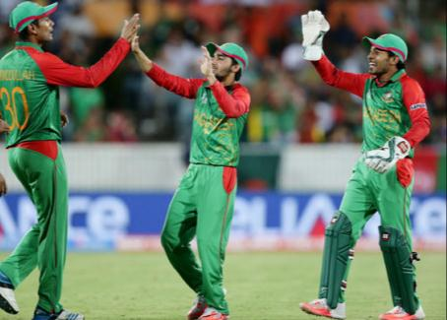

He has been dancing for 1 hour.
We have won the match.

Slide 10
There are four forms of present tense.
Present indefinite form
Present continuous form
Present perfect form
Present perfect continuous form

Slide 11
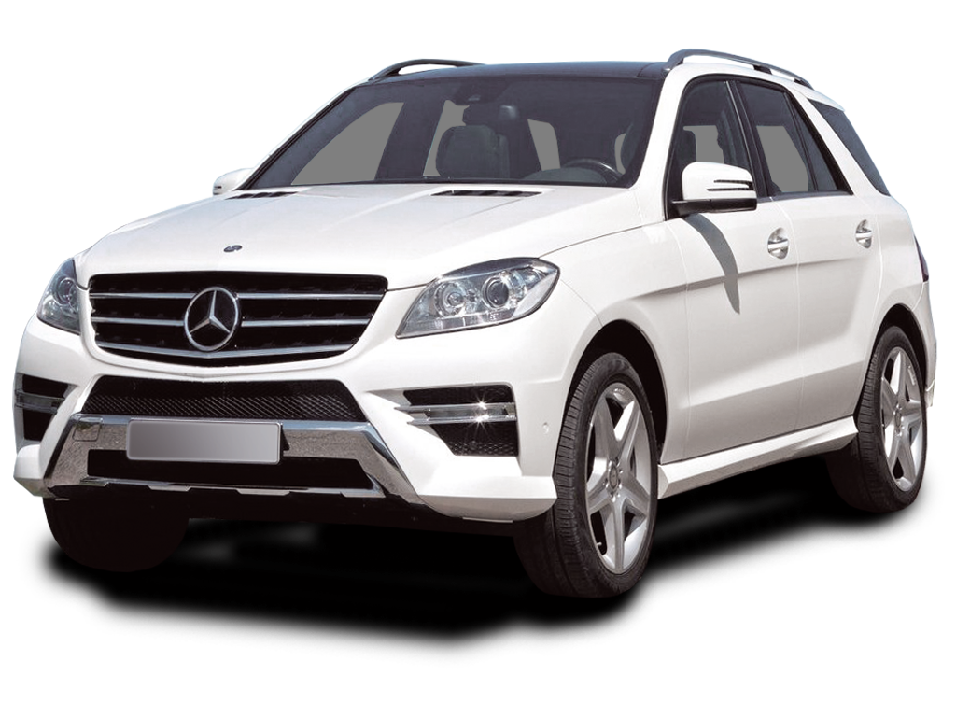
1. Present indefinite form
Structure : Subject + am/is/are/have/has/v₁ (s/es) + extension
You have a car .
Subject
Have
Extension
NOTE: If the subject is 3rd person singular number, s/es is added with V₁

Slide 12

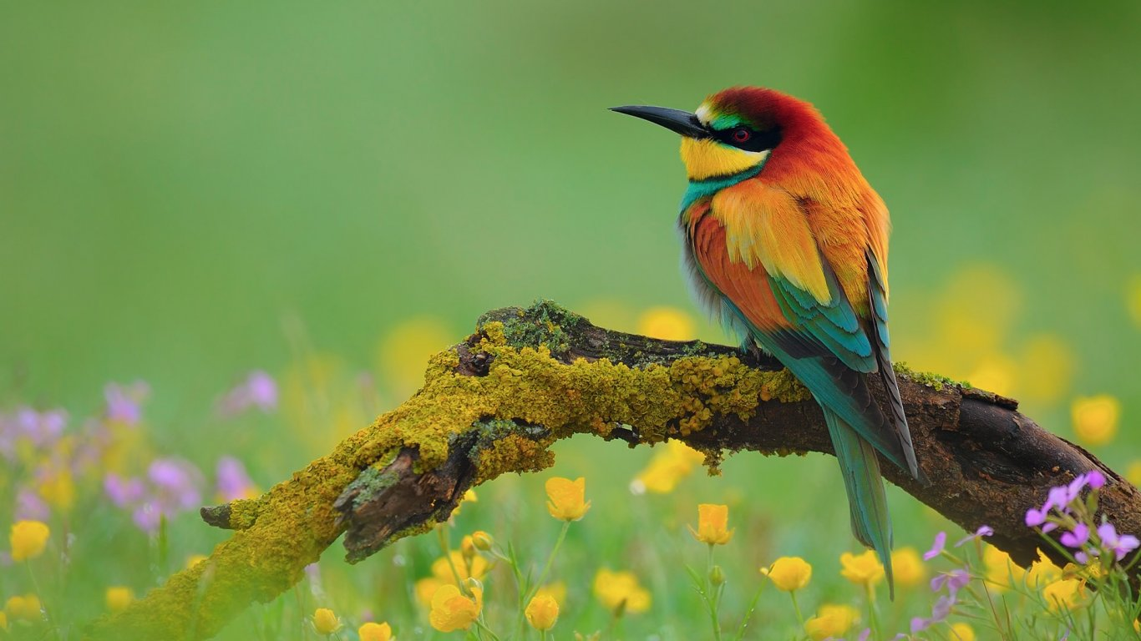
The bird looks very beautiful.
I have a pet dog.

Slide 13

Negative form of present indefinite tense.
Sub + be + not + Extension.
Sub + don’t +V₁ +Extension
Sub + doesn’t + V₁ + Extension
He is not a student.
He doesn’t go to school.

Slide 14

Interrogative form of present indefinite tense.
Be + sub + Extension +?
Do + sub +V₁ +Extension+?
Does + sub + V₁ + Extension+?
Is he a student?
Does he go to school?

Slide 15
Single work
Fill in the gaps with the right form of verbs from the box.
am | like | make | have | has
go | is | respect | ride | are
Amin (a)__________ a good student. He (b)________ to school regularly. I (c) _________ also a student. We (d) _________ at the same age. We (e) ________ a mutual understanding. Rahim (f) ________ a nice bicycle. We both (g) ________ it. We never (h)_______ any quarrel. All the teachers (i) ________ our friendship. We always (j) _______ our teachers.

Slide 16
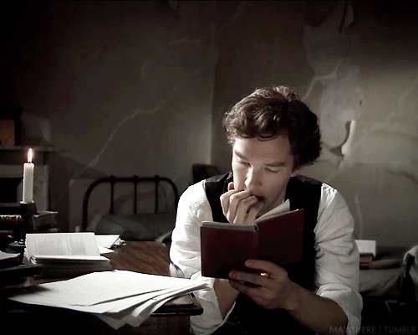
2. Present continuous tense
Structure : Subject +(be) am/is/are+ verb (ing) + extension.
He is reading book
‘am’ is used after ‘I’ only, after 3rd person singular number ‘is’ is used and ‘are’ is used in another places.

Slide 17
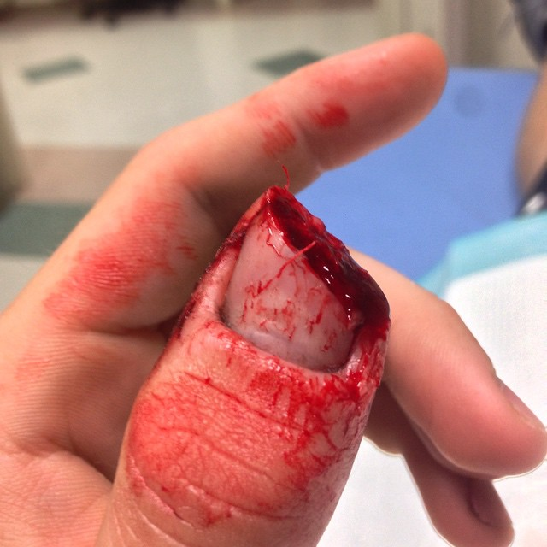
3. Present perfect tense
Structure : Subject +have/has+ V₃ (verb past participle)+ extension.
Ruma has cut her finger
Note: ‘Has’ is used after 3rd person singular number and ‘have’ is used in all other places.

Slide 18
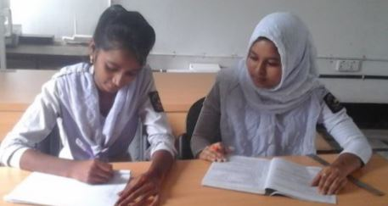
Pair work
Change the following sentences in the present perfect tense.
We win the game.
She kills a bird.
Hena sings a song.
Don’t they play.
You teach us English.
Do you read a book?
I buy a pen.

Slide 19
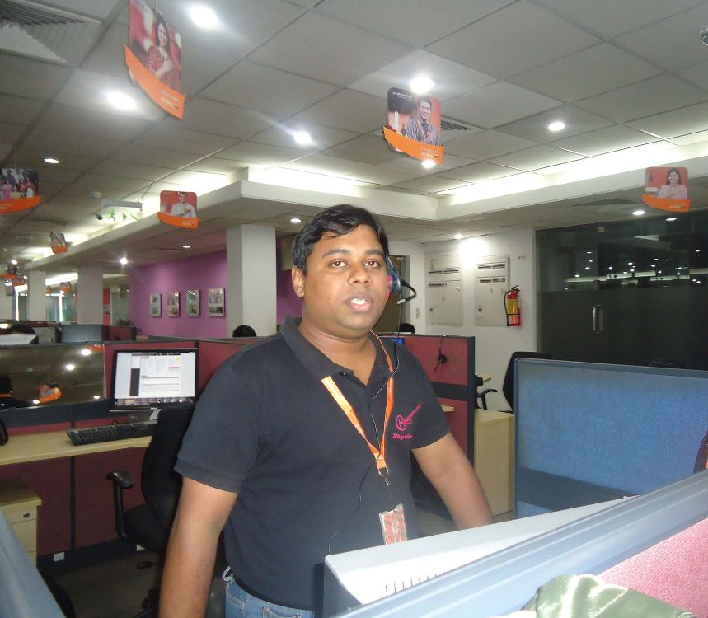
4. Present perfect continuous tense
Structure : Subject+ have been/has been+ verb (ing) + extension.
He has been working here since 2000
Note: ‘has been ’ is used after 3rd person singular number and ‘have been’ is used in all other places.

Slide 20
Group work
Fill in the blanks of the following sentences using the right form of verbs given in brackets.
The man ____(wait) at the station for three hours.(b) Mother____(cook) for two hours.(c) You____ (suffer) from fever for six days.(d) He___(waste) time for two years.(e) Kamal___(work) since morning.

Slide 21

Home work
Identify the structures of the following sentences.
This is the age of science and technology.
We have been enjoying a happy life for modern ICT.
The world cannot go for a single day without ICT.
Internet has created a new era for civilized world.
It is not possible for us to go without mobile phone.

Slide 22
Allah Hafiz

